Slide 1
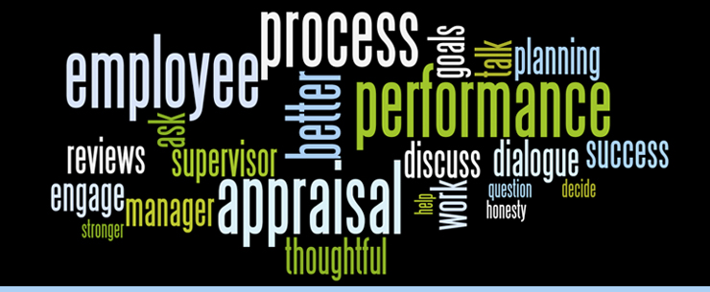

Performance Management

Slide 2
Performance Management
Beth Burns
Assistant Director of Human Resources

Slide 3

Performance Management
Performance Management processes are designed to focus on communication, engagement and performance improvement.
Performance Management is an ongoing process where employees and managers engage and collaborate to achieve desired business goals.
Together with managers, employees establish clear expectations, goals, and responsibilities.
Employees work to meet expectations through ongoing feedback and coaching from their manager.

Slide 4
Performance Management
Performance
Rating
Scale - Definitions

Slide 5
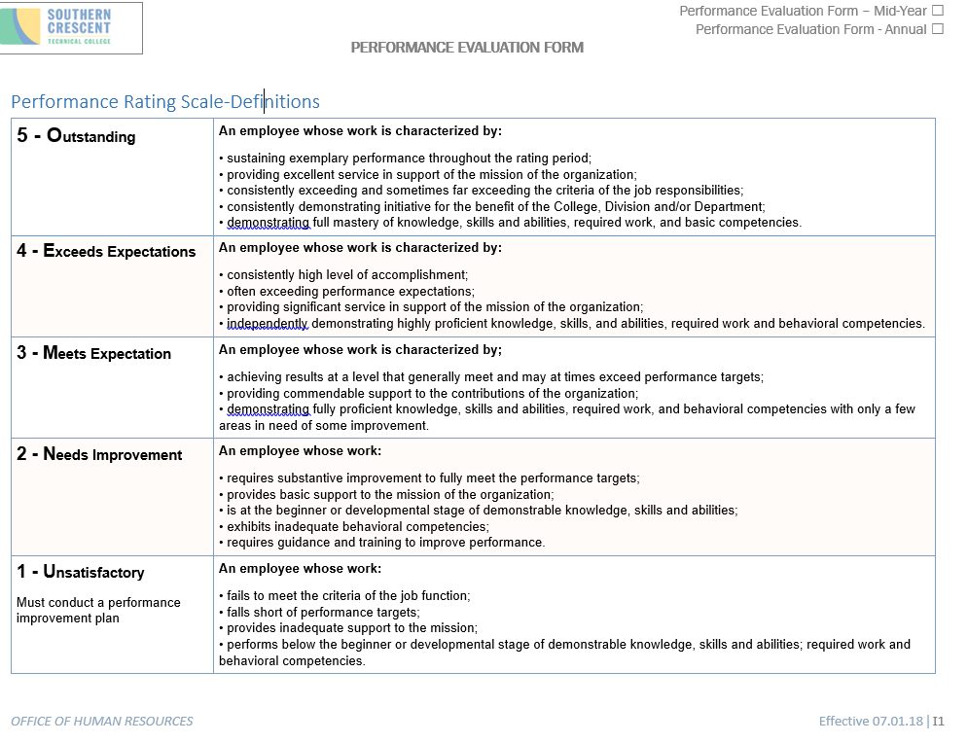
Performance Rating
Scale - Definitions
THE RATING SCALE OFFERS:
high degree of structure
several points ranging from “unsatisfactory" to “outstanding"
method to appraise an employee's job performance
same basic appraisal process and rating criteria, with the same range of responses.
equality in treatment for all employees
standard measures of performance across the organization
easy of use and easily understood
Allows the manager and employee to have an appreciation for the simple and efficient logic of the scale.
The result is widespread acceptance and popularity for this approach.

Slide 6
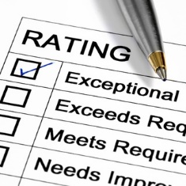
Performance Rating
Evaluation Competencies
Evaluations Competencies are based on three broad categories. Those categories are:
COLLEGE-WIDE PERFORMANCE FACTORS
JOB PERFORMANCE FACTORS
EMPLOYEE PERFORMANCE FACTORS

Slide 7
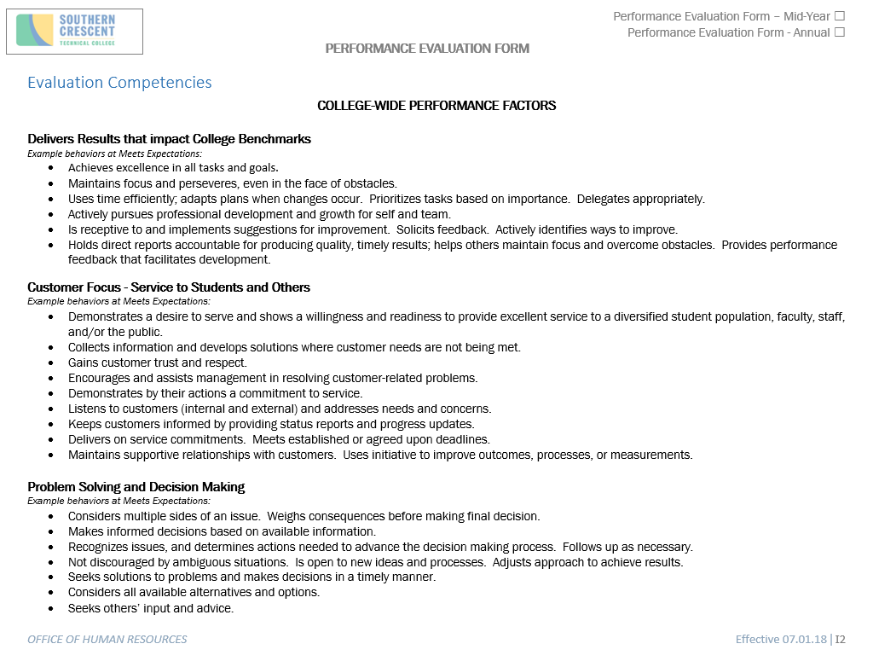
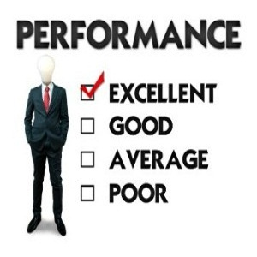
Performance Rating- Evaluation Competencies

Slide 8
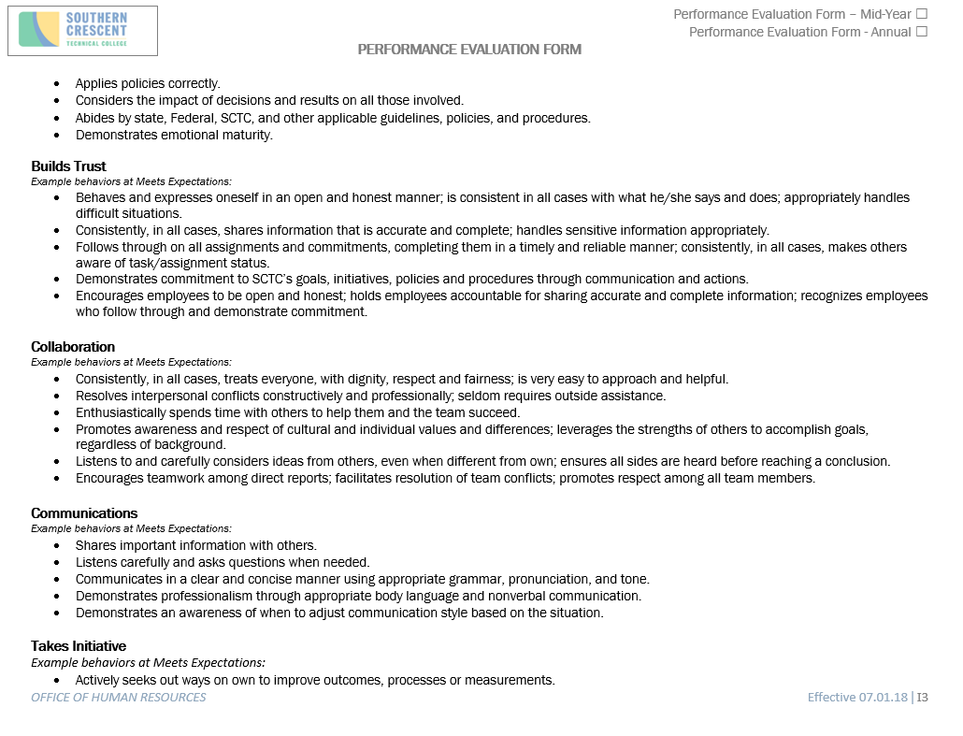
Performance Rating- Evaluation Competencies

Slide 9
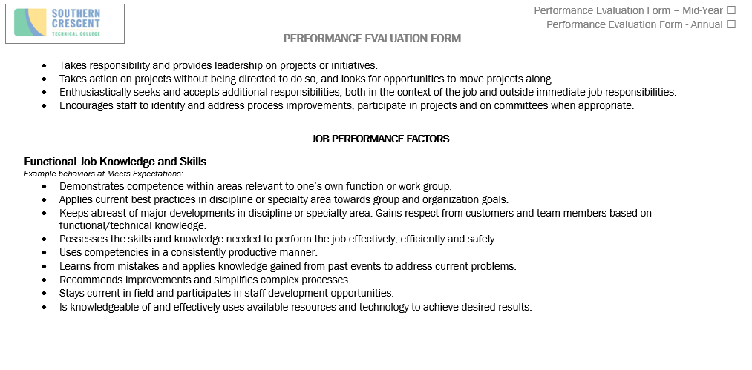
Performance Rating- Evaluation Competencies

Slide 10
Performance Rating- Evaluation Competencies
COLLEGE-WIDE COMPETENCY
ORGANIZATIONAL COMMITMENT
WHAT IS ORGANIZATIONAL COMMITMENT?
An employee's commitment to an establishment and desire to continue to be a part of it. It determines how an employee
feels about their jobs so he/she would become more committed to the organization.
Organizational commitment predicts work variables such as turnover, organizational citizenship behavior, and job performance. Some of the factors such as job stress, empowerment, job insecurity and employability, and distribution of leadership have been shown to be connected to a worker's sense of organizational commitment.

Slide 11
Performance Management
Performance
Evaluation
Factors

Slide 12
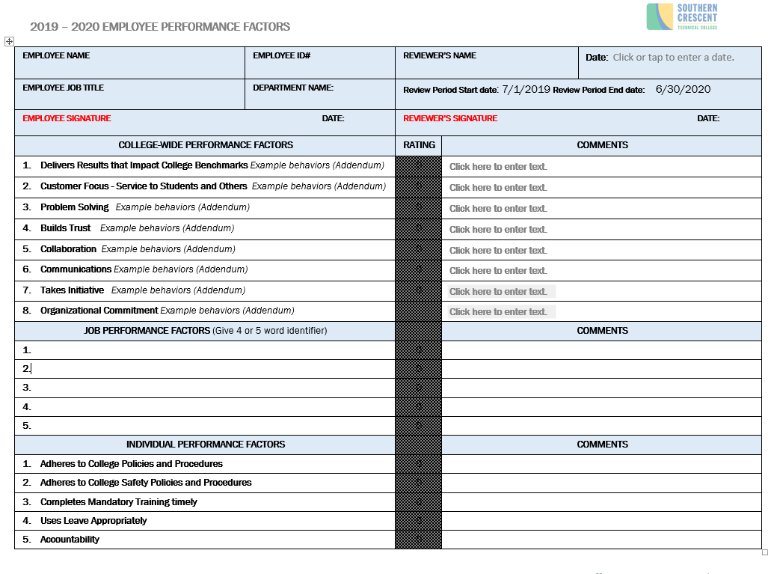
Employee Performance Factors

Slide 13
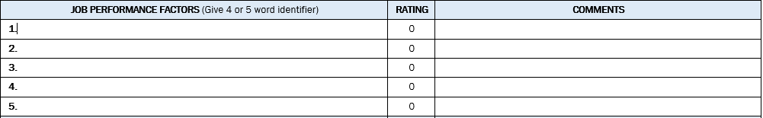

Performance Evaluation Form
Job Performance Factors
Supervisors must utilize the following criteria:
Factors should cascade down from manager’s performance factors
Must include employee’s job functions as they relate to the manager’s performance factors
Job functions must be included on employee’s job description
Must be measurable
Must be realistic
Must use good descriptors when identifying performance factors

Slide 14
Performance Management
Performance
Evaluation
Form

Slide 15
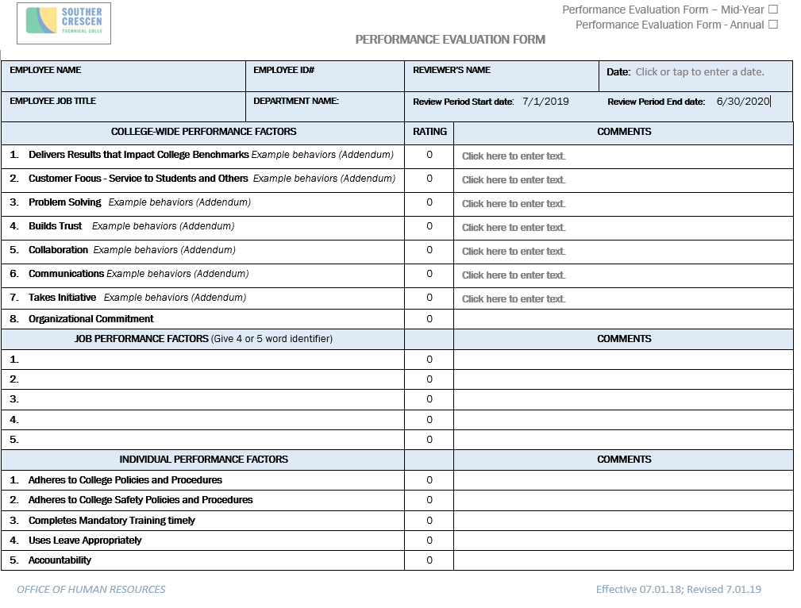

Slide 16
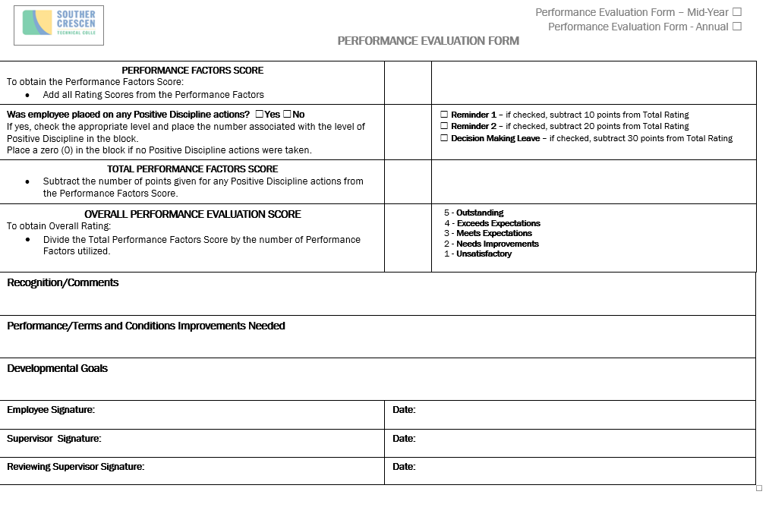

Slide 17
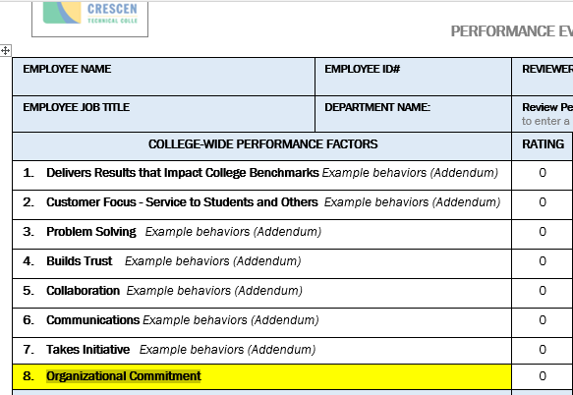
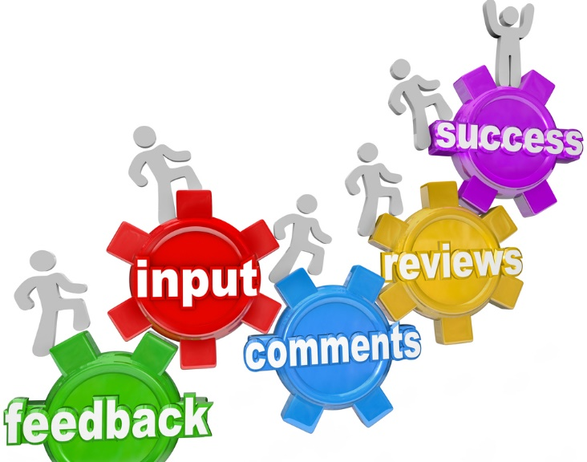
Performance Evaluation Form
College-wide Performance Factors

Slide 18

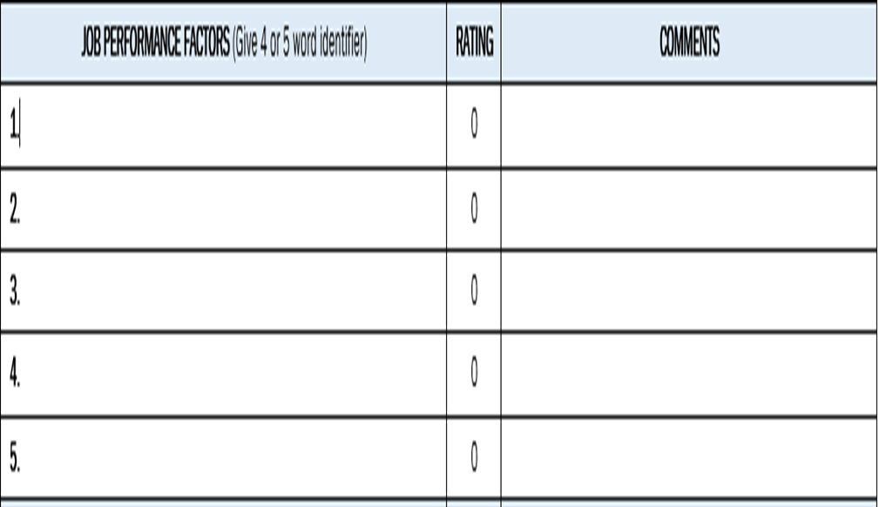
Performance Evaluation Form
Job Performance Factors

Slide 19
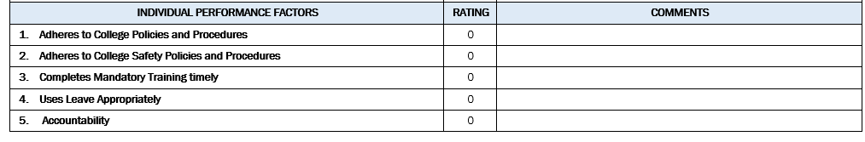

Performance Evaluation Form Individual Performance Factors
Ratings in this section may not always warrant a “5” rating which is “Outstanding”.
Why?

Slide 20
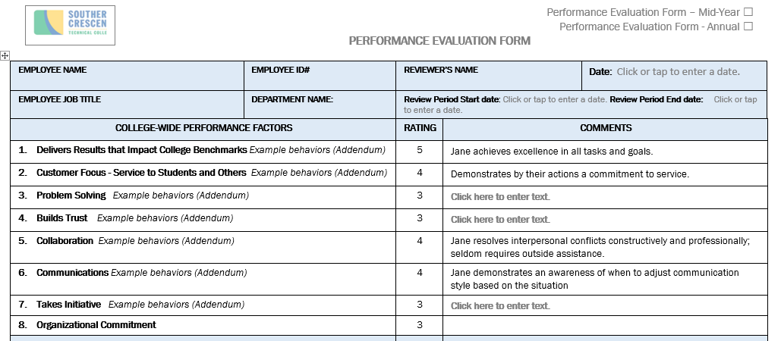
Performance Evaluation Form
No comments are required if a rating score of 3 is given
Comments must be included if an employee is given a 4 or 5 rating score
Give specific examples of what the employee did to warrant a rating score above a 3
Utilize the employee’s name in the comments

Slide 21
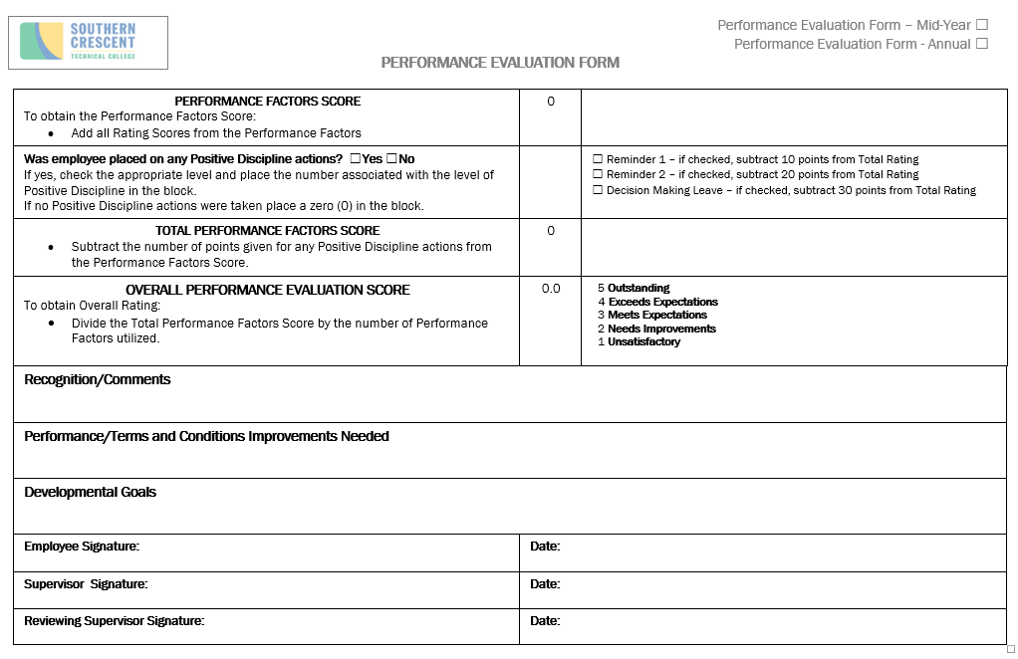
Performance Evaluation Form
Make sure the reviewing supervisor has reviewed the performance evaluation form prior to having the performance discussion with the employee
Make sure the Evaluation Form is signed by the following prior to submitting it to Human Resources:
Employee
Supervisor
Reviewing Supervisor

Slide 22
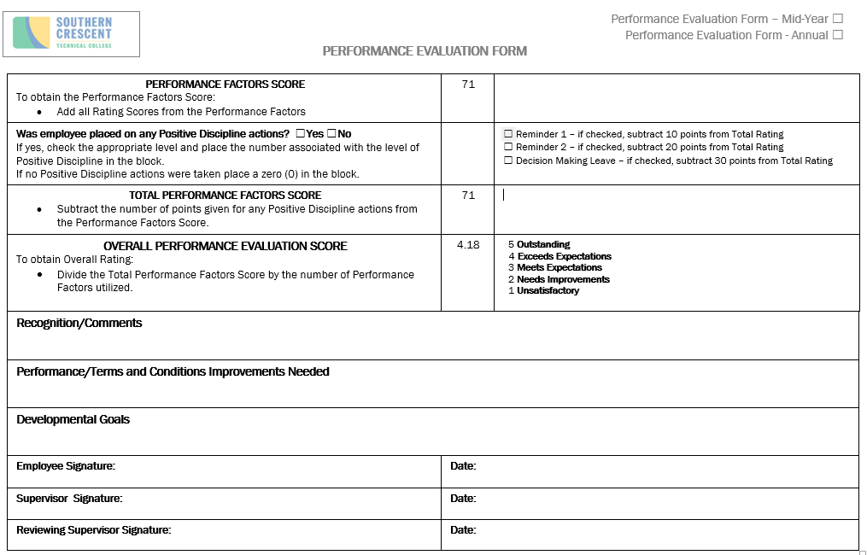
Performance Evaluation Form
Click F9
Click F9
Click F9

Slide 23

Performance Evaluation Form
Click F9
Click F9

Slide 24
Performance Management
Due Dates

Slide 25

Performance Management
Procedure
Employees should have a performance plan in place within 45 calendar days of the employee being placed in a new job or the beginning of a new performance period. Performance Factors are due September 30th.
At least once during the performance period, supervisors are to conduct and document a mid-year evaluation. Mid Year evaluations are due January 30th.
Annual Performance Evaluation forms must be acknowledged and signed by the employee immediate supervisor and the reviewing supervisor. Annual Evaluations are due July 30th.

Slide 26
Performance Management
Performance
Improvement Plan

Slide 27
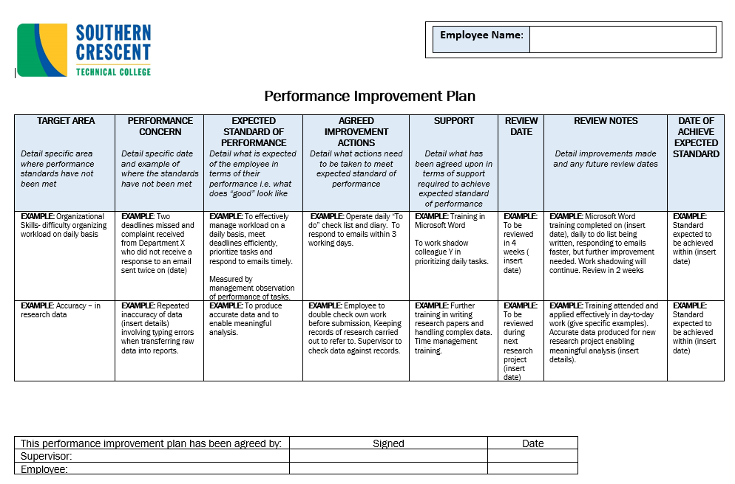
Performance Evaluation Form
Performance Improvement Plan

Slide 28
Performance Management
Performance
Management
Procedure

Slide 29
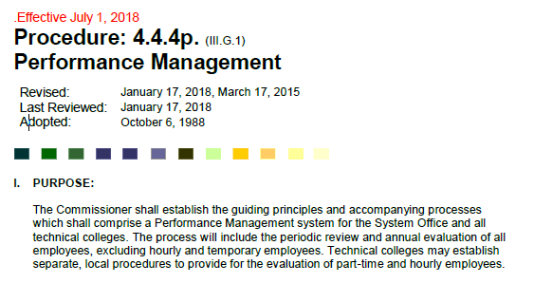
Performance Management
SUPERVISORS WILL PROVIDE EMPLOYEES WITH THE FOLLOWING FOR EACH PERFORMANCE PERIOD:
  performance plan
  ongoing feedback
  interim evaluation a
  annual performance evaluation
Southern Crescent Technical College has a fixed 12-month performance period for the purpose of evaluating employees as described in this procedure (July 1 - June 30).
Evaluations are required for all full-time and part-time salaried/hourly employees. Annual evaluations are due July 30th.
Employees who began employment less than three months before the end the performance period are exempt from the performance evaluation process.
Evaluations will be conducted using a five-point rating scale.

Slide 30
Performance Management
Employees should have a performance plan in place within 45 calendar days of the employee being placed in a new job or the beginning of a new performance period.
A performance plan may be modified at any point during the performance period and must be modified when new responsibilities or expectations are added.
Employees must be informed of any substantive changes within 15 calendar days of the modification.
Employees may request a review of their performance plans if they consider the expectations to be non-job related or unachievable.
At least once during the performance period, supervisors are to conduct and document an interim evaluation. Interim evaluations are due January 30th.
Performance evaluations must be acknowledged and signed by the employee and the immediate supervisor.
Employees may request a review of their annual performance evaluation if the overall summary rating is “unsatisfactory” or its equivalent, and they disagree with such rating.
30

Slide 31
Performance Management
Performance
Management
Timeline

