Slide 1

SOUTHERN CRESCENT TECHNICAL COLLEGE
LIBRARY ORIENTATION & INSTRUCTION

Slide 2

PRICES
Black & White Printing and copies --- .10 per page
Color Printing and copies --- .25 per page
Scanning to a Flash Drive --- Free
Printing
in the
Library
PRINTING
Only students enrolled in a class in the current semester have printing accounts.
When you enrolled in Southern Crescent, you were given a one-time print allowance of $15. If you use up the $15 allowance, you can add money to this account by paying cash at the circulation desk.
*Please note that the library only accepts cash payments-- no cards or checks.
GUEST COMPUTERS
If you are not enrolled in a current class, please use the guest computers in the center of the library for printing without a student account.

Slide 3
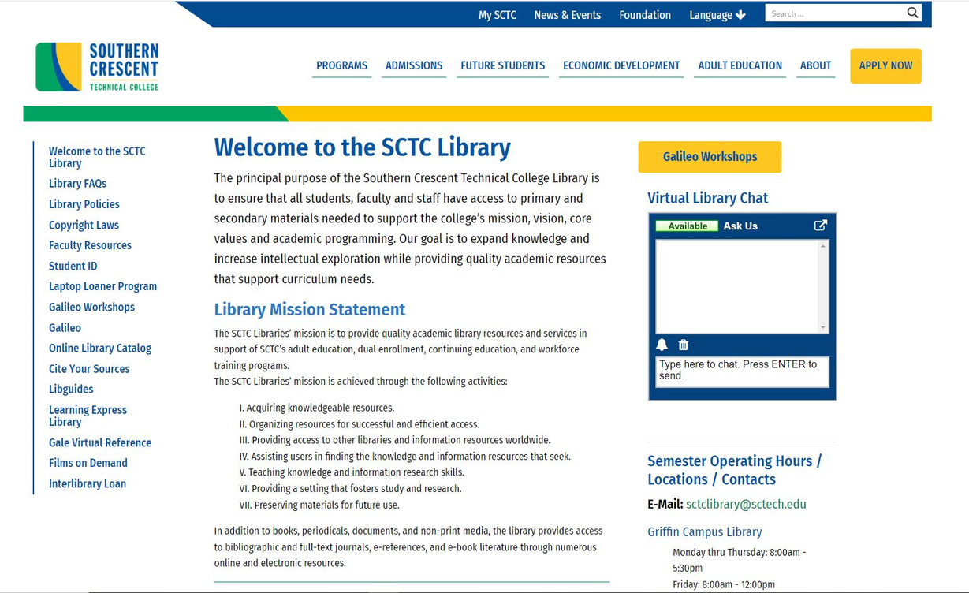
GALILEO
Georgia's virtual library portal to authoritative, subscription-only information that isn’t available through free search engines or internet directories.
Start from our webpage:
www.sctech.edu/library
LIBGUIDES
Guides organizes class and subject specific resources.
GALE VIRTUAL REFERENCE
Full text ebooks available for your use.
FILMS ON DEMAND
Video clips, full length specials, and television segments on a wide array of subjects.
ONLINE LIBRARY CATALOG
Search SCTC Library’s physical and digital resources

Slide 4
WAYS TO SEARCH
Use the search bar to do a general search and add search limiters as needed, browse by subject, or browse by type of resource (i.e. newspaper articles, ebooks, etc.)
Galileo
Crash Course
SAVE TIME
Narrow your search results to only full-text or peer-reviewed items to weed out unhelpful results.
CUT THROUGH THE SLOG
Don't waste time reading entire articles only to discover they aren't related to your topic, or are similar to other resources you've found-- read the abstracts first.
FOLLOW THE TRAIL
Research is often built upon existing research. If you've found a great article, scan the works cited and search for authors from it.

Slide 5
AND
Combine two words or phrases: video games AND violence
Boolean Operators
OR
Broaden your search to find all results that include one or both of your keywords: cars OR automobiles
NOT
Eliminate a specific term from search results:
Athens NOT Georgia

Slide 6
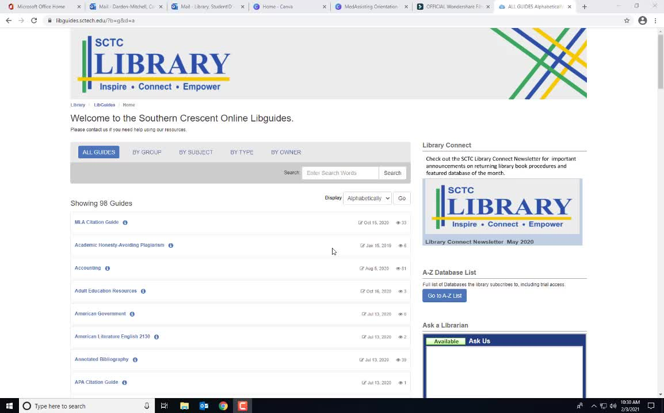
LIBGUIDES.SCTECH.EDU

Slide 7
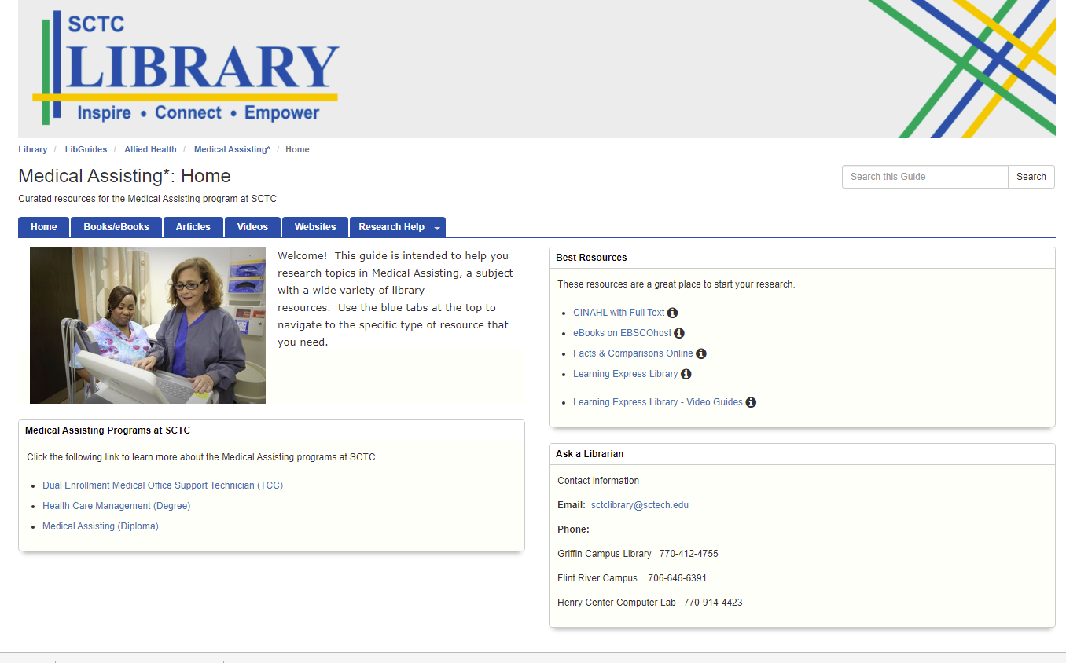

Slide 8
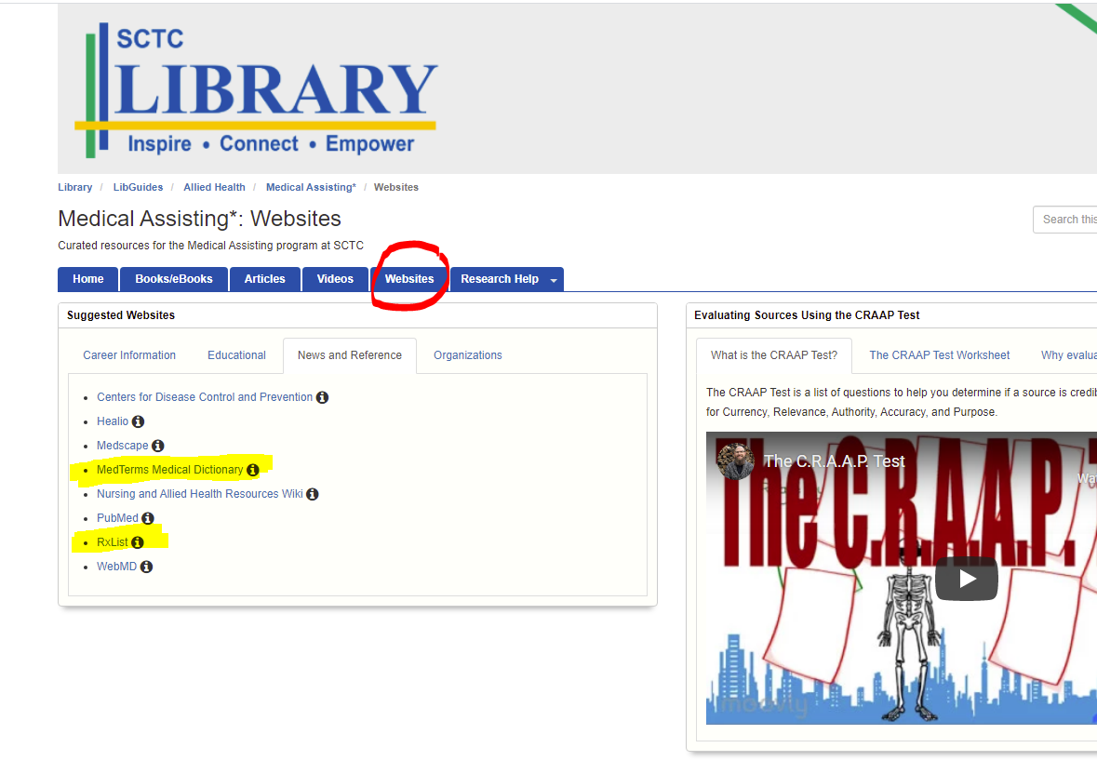

Slide 9
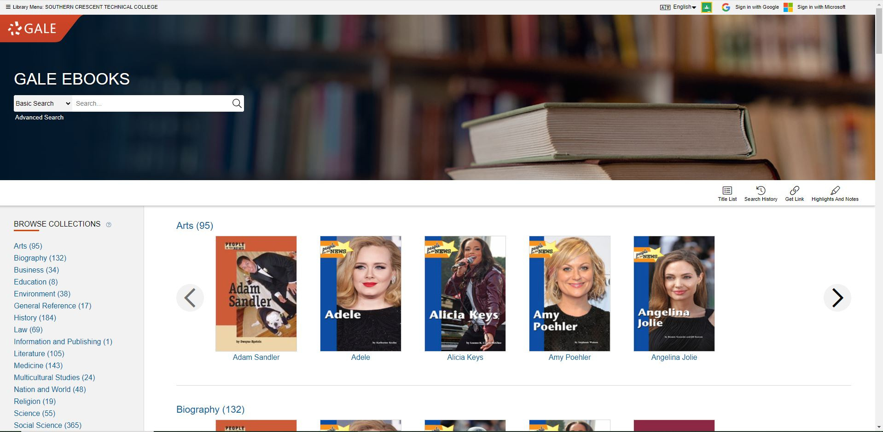
Gale Virtual Reference

Slide 10
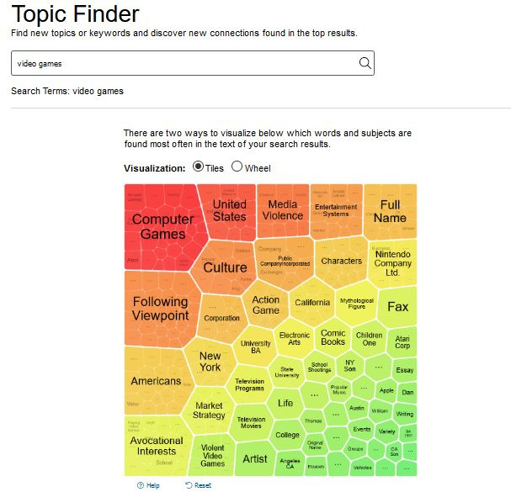

Gale Virtual Reference
Topic Finder search for
Video Games

Slide 11
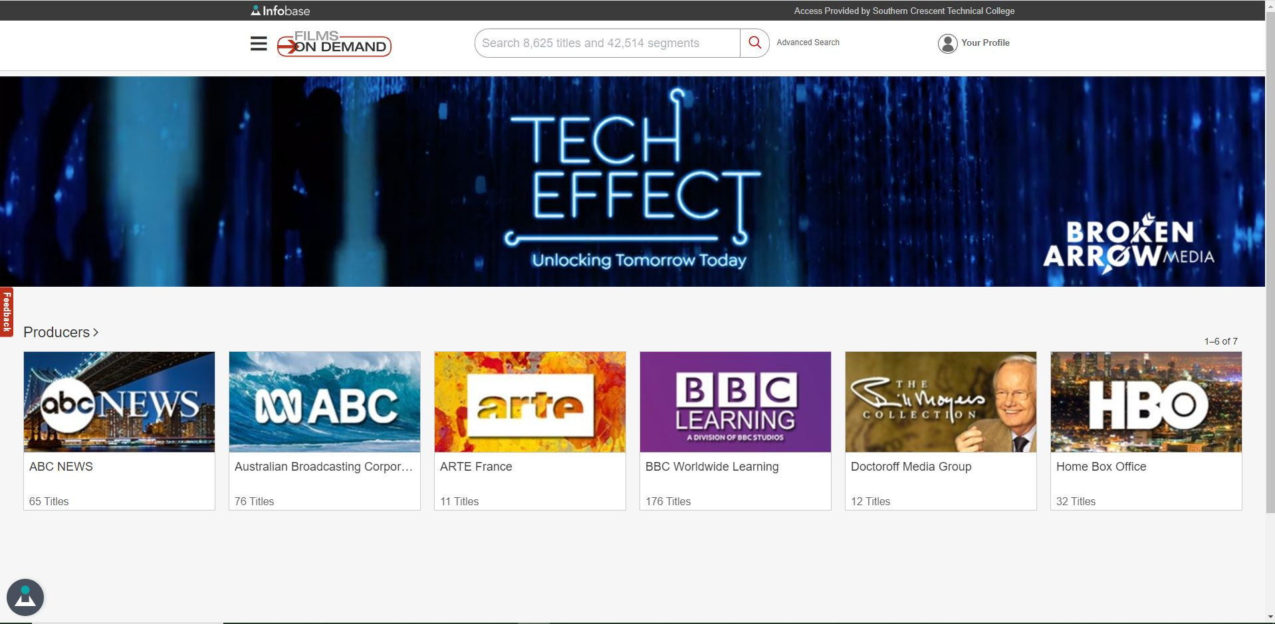
Films on Demand

Slide 12
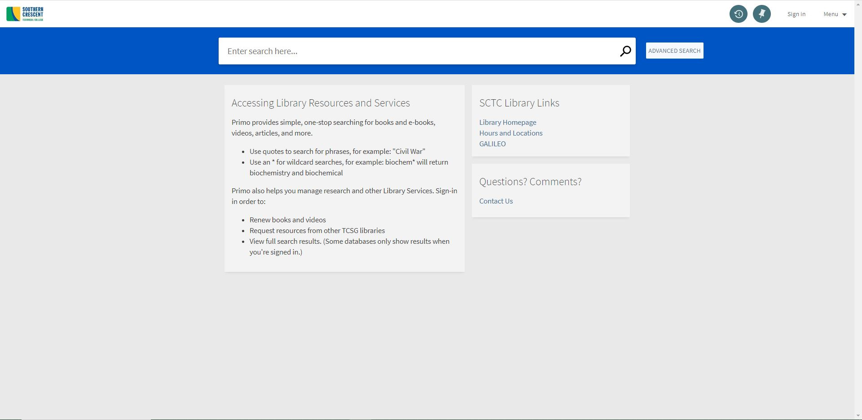
Online Library Catalog

Slide 13
Currency
When was it published or updated?
Relevancy
Are your sources a load of CRAAP?
How does it relate to your topic or question?
Authority
Who is the author/publisher/creator?
CRAAP TEST
Accuracy
Developed by Sarah Blakeslee at California State University, Chico.
Is it reliable, verifiable, and error-free?
Purpose
Does it seem impartial and fact-based?

Slide 14
Avoid Plagiarism:
When in doubt, cite!
-quotes
-summaries
-paraphrasing
Attribution
is
everything
www.citefast.com
owl.purdue.edu

Slide 15
CONCEPTS:
Boolean Operators
Gale Topic Finder
When in doubt, cite!
Key
Takeaways
CRAAP Test your sources
LINKS:
www.sctech.edu/library
www.citefast.com
owl.purdue.edu

Slide 16
Where to
find help
Flint River Campus Library
Building B1533
Highway 19 South
Thomaston, GA 30286
706-646-6173
Mon thru Thurs: 8am -5:30 pm
Friday: 8am - 12pm
Closed Saturday and Sunday
SCTC LIBRARIES
Griffin Campus Library
Upstairs in the Technology Building
501 Varsity Road
Griffin, Georgia 30223
770-412-4755
Monday thru Thursday: 8:00am - 5:30pm
Friday: 8:00am - 12:00pm
Closed Saturday and Sunday
Henry County Computer Center
Room 126300
Lakemont Drive
McDonough, GA 30253
770-914-4423
Mon thru Thurs: 8am -5:30 pm
Closed Friday, Saturday, and Sunday

